Slide 1

HOF UNIVERSITY OF APPLIED SCIENCES
Autonomous Mobile Robot with LiDAR Mapping
UGV02 Platform + Jetson Xavier Nano + RPLiDar A1

Slide 2
2
Team members
Orozbekov Emir
Asykpaeva Kyial
Munduzbaeva Altynai
Alieva Nargiza
Tynymbekova Zhanetta
Hryshyna Hanna

Slide 3
3
Project Motivation
Growing importance of autonomous mobile robots
Need for safe navigation and obstacle avoidance
Integration of ROS, LiDAR, and embedded systems

Slide 4
Project Goal
4
Build an autonomous mobile robot
Real-time obstacle detection using
LiDAR
ROS-based software architecture
High-level control on Jetson,
motor control on ESP

Slide 5
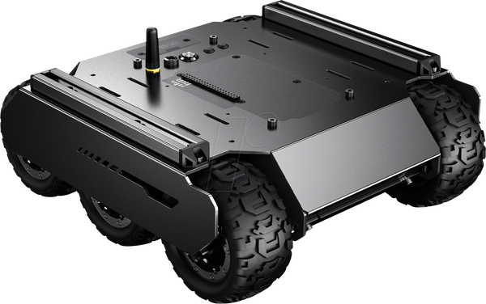
Robot Platform Overview
5
UGV02 tracked robot platform
Indoor navigation
Stable movement

Slide 6
Main Hardware Components
6
Jetson Xavier Nano (main computer)
LiDAR sensor
Motor controller + motors
Battery system

Slide 7
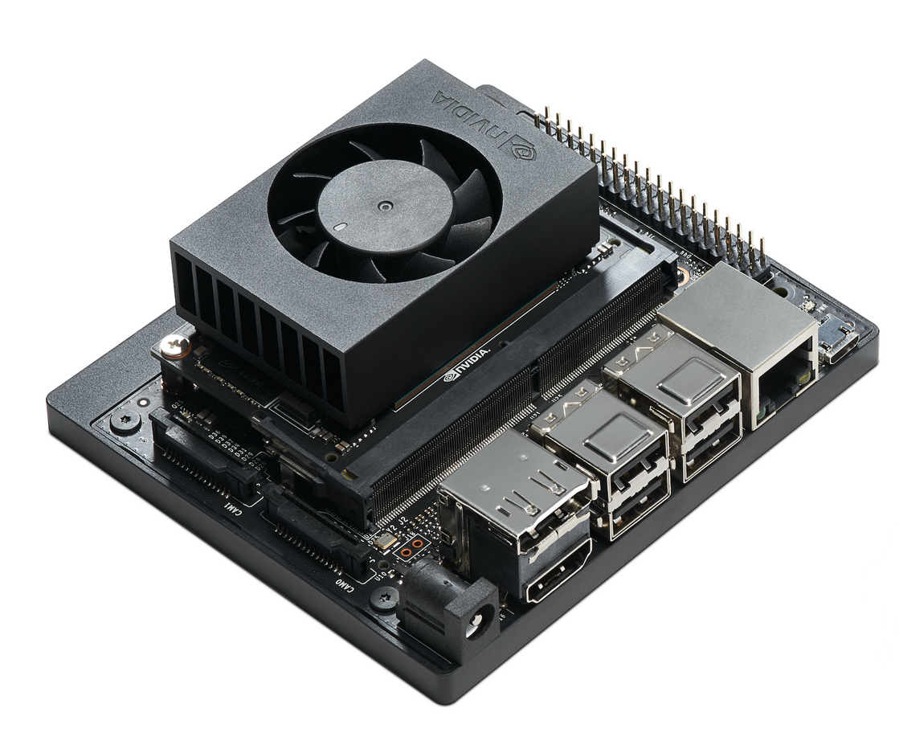
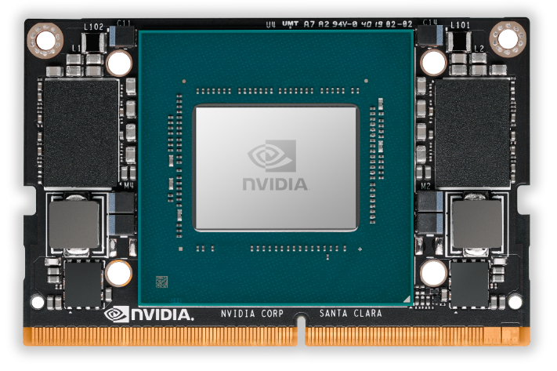
7
Why Jetson Xavier Nano
Ubuntu + ROS support
Real-time processing
Suitable for robotics applications
No ML required

Slide 8
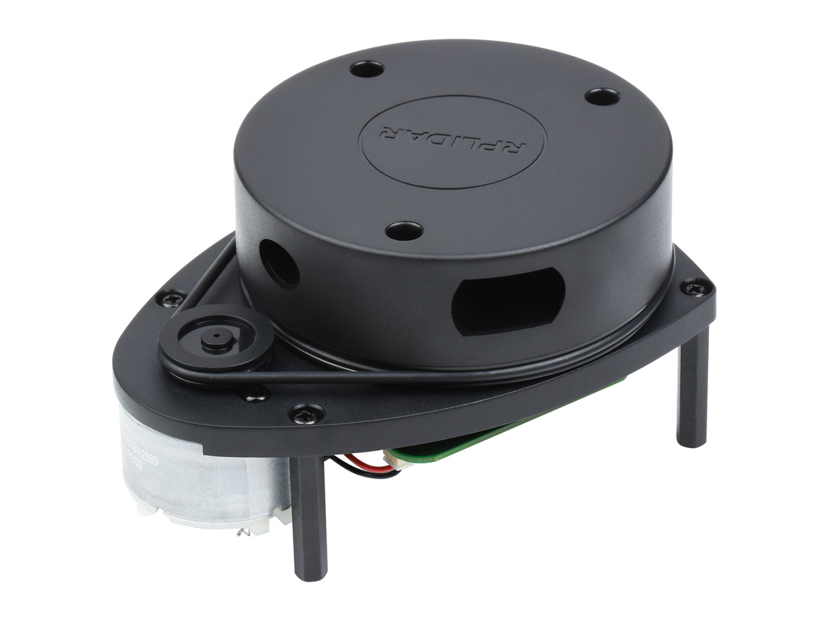
8
Why LiDAR
Accurate distance measurement
Lighting independent
Reliable obstacle detection
Suitable for indoor mapping

Slide 9



9
Software Environment
ROS (Robot Operating System)
Ubuntu Linux
Python-based nodes

Slide 10

10
ROS Architecture
publishes /scan (sensor_msgs/LaserScan)
publishes /map, /tf, /path
Visualization (RViz)
shows /map, /scan,
robot path + obstacles
LiDAR
(LaserScan sensor)
ROS
Nodes + Topics bus
subscribes /scan
publishes /map
(nav_msgs/OccupancyGrid)
Jetson
Control / Navigation
obstacle avoidance logic
Motor Controller
sends HTTP JSON L / R -> PWM
Motors
Mapping (SLAM)
builds occupancy grid map
publishes HTTP JSON

Slide 11
11
Sensor Data Flow
/scan — LiDAR data
Data published continuously
Used by: mapping, obstacle detection
LiDAR
(LaserScan sensor)
publishes /scan
Obstacle Detection
/ Control Logic subscribes to /scan
Mapping (SLAM)
subscribes to /scan

Slide 12
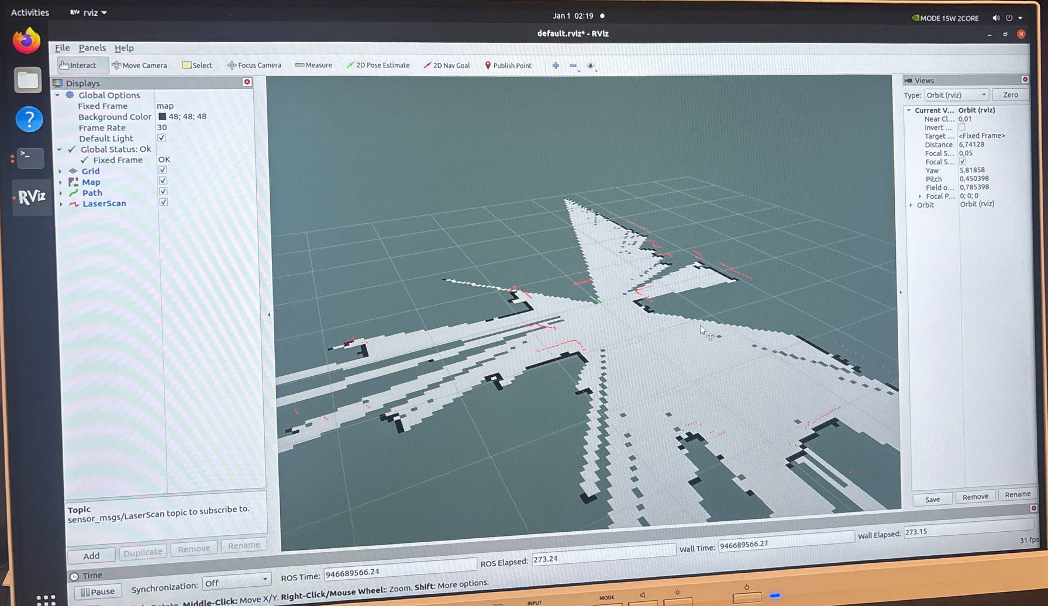
12
Mapping Process
SLAM-based mapping
Robot builds map while moving
Map updated in real time

Slide 13
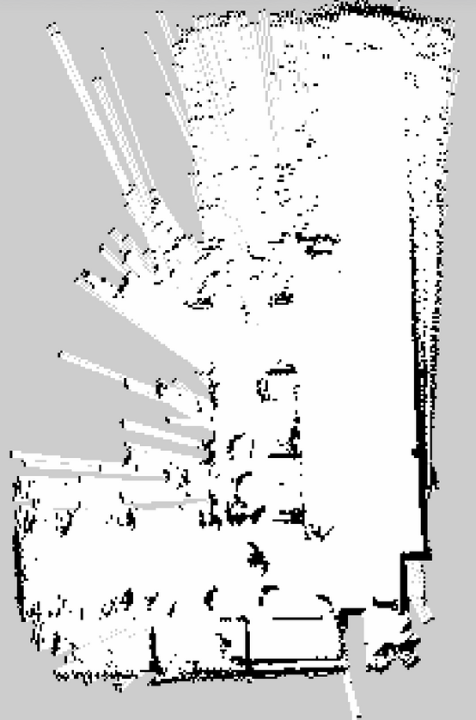
13
Map Visualization
White — free space; Black — obstacles; Line — robot path

Slide 14
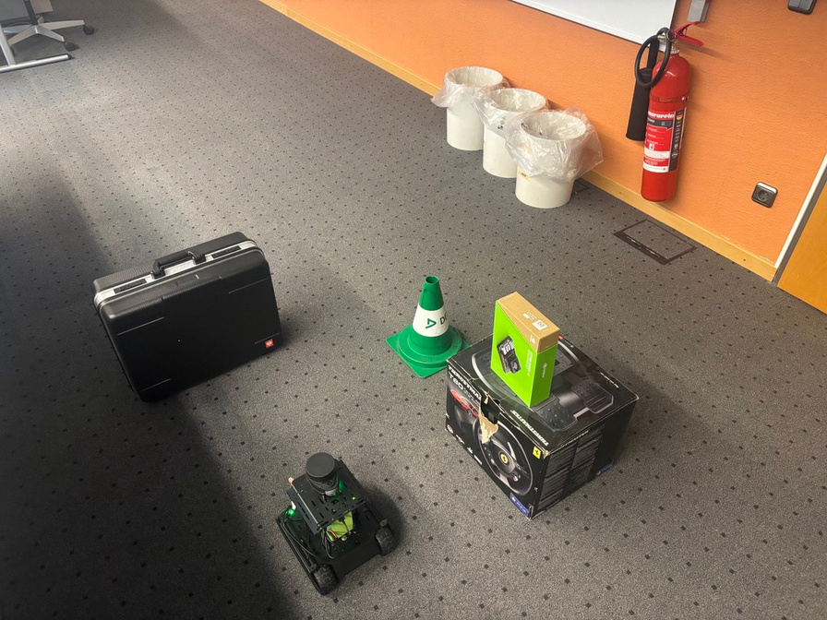

14
Obstacle Detection
Based on LiDAR scan data
Obstacles detected in real time
Marked on visualization
https://drive.google.com/file/d/1JgAfv8gvsPmnohkQ3jNif7fIq2BTtJEe/view?usp=drive_link

Slide 15
15
Robot Control Logic
LiDAR
(LaserScan sensor)
NO
Move Forward
/ Turn
Obstacle Check
Distance < threshold?
YES
STOP
(emergency)
Motor Command
(/HTTP JSON L / R)

Slide 16






16
Robot Operating Modes
16
STOP
MAP
AUTO
Immediate motor stop
Emergency & safety mode
No motion commands sent
LiDAR & sensor processing active
Autonomous navigation
Real-time obstacle avoidance

Slide 17

17
Current Results
Real-time obstacle detection and avoidance
Stable LiDAR scanning
Successful map generation
Clear distinction between free space, obstacles, and unknown areas
Autonomous navigation in AUTO mode

Slide 18

18
Demonstration Status
Live demo unavailable (battery)
System fully functional
Full video by January 30

Slide 19

19
Challenges and Limitations
Limited battery life
Restricted test environment
ROS configuration complexity

Slide 20
20
Future Improvements
Improved power management
Camera integration
Advanced navigation
Possible ML extension

Slide 21
Thank You

